Slide 1
Topic : Cloud Computing
Presented By: Manoj Kumar

Slide 2
Contents
1
Introduction?
What is Cloud Computing?
Advantages of Cloud Computing
Disadvantages of Cloud Computing
Types of Cloud Computing
Cloud Computing Architecture
Conclusion

Slide 3
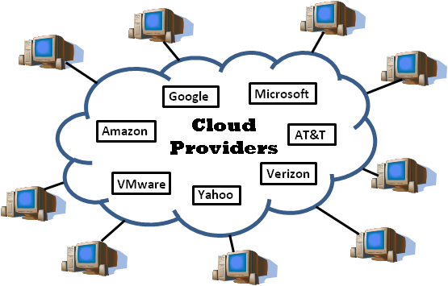
Introduction
2
Cloud computing is Internet-based computing, whereby shared resources, software, and information are provided to computers and other devices on demand, like the electricity grid.
Cloud computing is a paradigm shift following the shift from mainframe to client–server in the early 1980s. Details are abstracted from the users, who no longer have need for expertise in, or control over, the technology infrastructure "in the cloud" that supports them.

Slide 4
What is Cloud Computing?
3
Cloud computing is Internet based computing where virtual shared servers provide software, infrastructure, platform, devices and other resources and hosting to customers on a pay-as-you-use basis.
All information that a digitized system has to offer is provided as a service in the cloud computing model. Users can access these services available on the "Internet cloud" without having any previous know-how on managing the resources involved.

Slide 5
Advantages of Cloud Computing
4
Increased Storage Capacity :Increased Storage Capacity is another benefit of the cloud computing, as it can store more data as compared to a personal computer.
Easy to Learn and Understand: Since people are quiet used to cloud applications like Gmail, Google Docs, so anything related to the same is most likely to be understood by the users.
Easier Management of Data and Information: Since all data are located on a centralized location, data are more organized making it easy to manage
Automatic Updating: It saves companies time and effort to update multiples server.
Flexibility: There is a high rate of flexibility.

Slide 6
Disadvantages of Cloud Computing
5
Dependency: One major disadvantages of cloud computing is user’s dependency on the provider.
Risk: Cloud computing services means taking services from remote servers.
Requires a Constant internet connection: The most obvious disadvantage is that Cloud computing completely relies on network connections.
Security: Security and privacy are the biggest concerns about cloud computing.
Migration Issue: Migration problem is also a big concern about cloud computing.

Slide 7
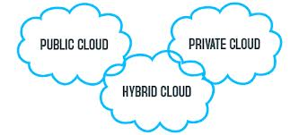
Types of Cloud Computing
6

Slide 8
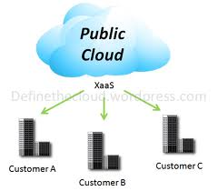
Types of Cloud Computing
7
PUBLIC CLOUD
Public clouds are made available to the general public by a service provider who hosts the cloud infrastructure. Generally, public cloud providers like Amazon AWS, Microsoft and Google own and operate the infrastructure and offer access over the Internet.
With this model, customers have no visibility or control over where the infrastructure is located. It is important to note that all customers on public clouds share the same infrastructure pool with limited configuration, security protections and availability variances.

Slide 9
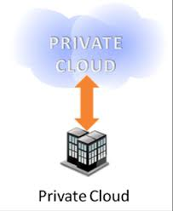
Types of Cloud Computing
8
PRIVATE CLOUD
Private cloud is cloud infrastructure dedicated to a particular organization. Private clouds allow businesses to host applications in the cloud, while addressing concerns regarding data security and control, which is often lacking in a public cloud environment.
It is not shared with other organizations, whether managed internally or by a third-party, and it can be hosted internally or externally.

Slide 10
Types Of Cloud Computing
9
HYBRIDCLOUD
Hybrid Clouds are a composition of two or more clouds (private, community or public) that remain unique entities but are bound together offering the advantages of multiple deployment models.
In a hybrid cloud, you can leverage third party cloud providers in either a full or partial manner; increasing the flexibility of computing. Augmenting a traditional private cloud with the resources of a public cloud can be used to manage any unexpected surges in workload.

Slide 11
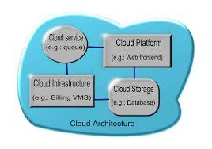
Architecture
10
Cloud architecture, the systems architecture of the software systems involved in the delivery of cloud computing, typically involves multiple cloud components communicating with each other over application programming interfaces, usually web services.

Slide 12
Conclusion
14
So, while cloud computing is really really great and you’re probably already using it, either for business of for personal means, here’s what we’ve learned from taking a look at the pros and cons:
Cloud computing is a really cheap way for companies to have all the resources they need in once place.
It’s a much better way to spread your resources, and it becomes easier to access things from longer distances.

Slide 13


